Slide 2
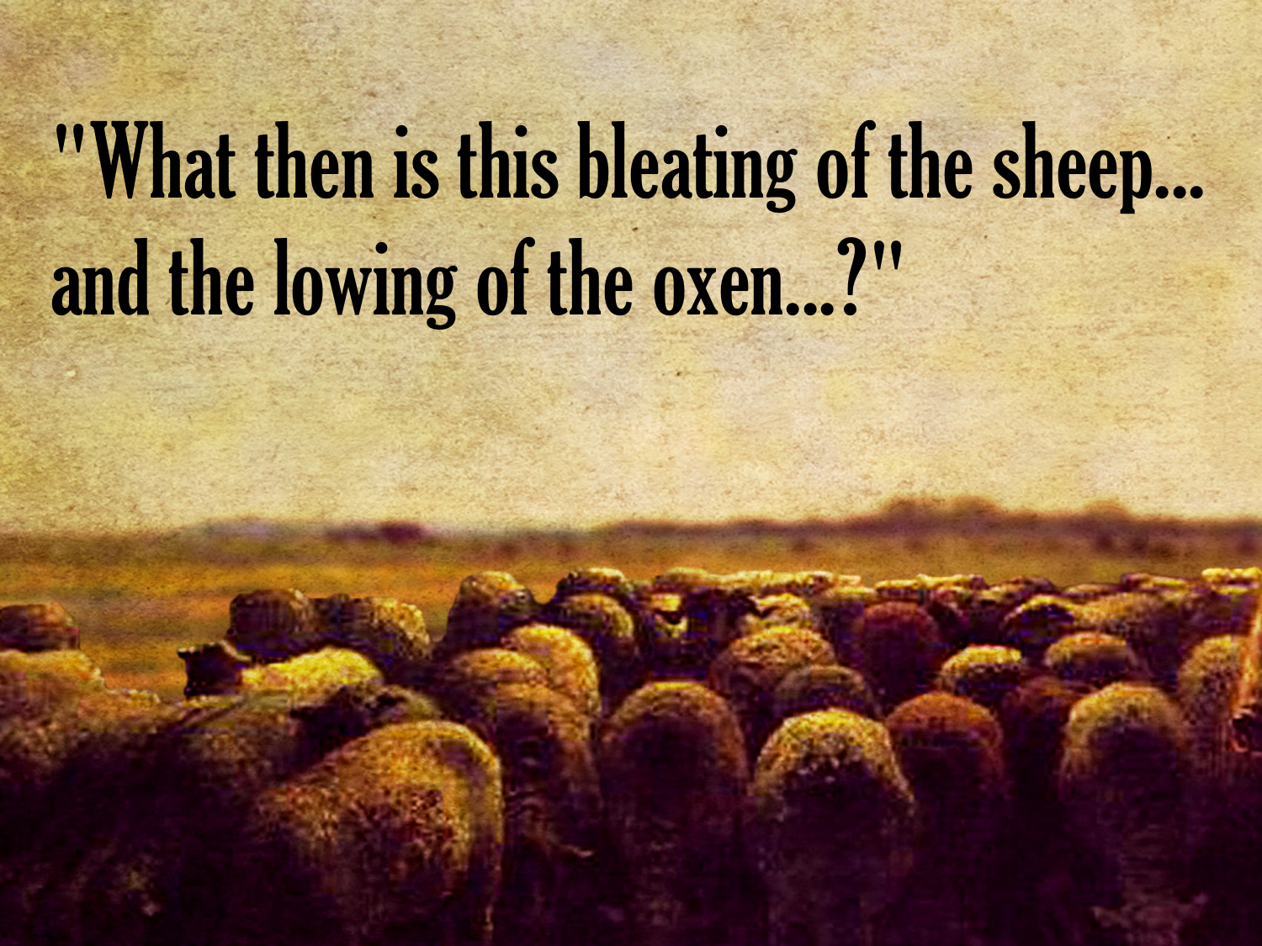

Slide 3
Lessons From Saul
We must respect God’s WILL
  Saul "obeyed" God with two exceptions: king Agag & the flocks and herds.
  PARTIAL obedience is COMPLETE disobedience
  Disobedience is REBELLION and STUBBORNNESS

Slide 4
Lessons From Saul
We must let go of PRIDE
  Disobedience frequently springs from SELFISHNESS and having an EXALTED opinion of oneself.
  He thought his way was BETTER, Isaiah 55.8-9
  His pride led to his DESTRUCTION, Prov. 16.2, 18, 25

Slide 5
Lessons From Saul
We must not shift BLAME
  God has a way of bringing SIN to the SURFACE, Num. 32.23
  Many times we want to blame someone else for our OWN sinful conduct, but God will hold each of us INDIVIDUALLY ACCOUNTABLE, Ezek. 18.20

Slide 6
Points To Take Away
We displease God when we are DISSATISFIED with His ways.
When we go against the Word of God, we ELEVATE our will above divine instruction.
God wants obedience from the HEART, not mere outward ritual.

Slide 7
Points To Take Away
Obedience ALWAYS involves sacrifice; but sacrifice is not always obedience
GOOD MOTIVES do not take the place of humble, full obedience
There are consequences of not only disobedience but also INCOMPLETE obedience

Slide 8
GOD’S PLAN FOR MAN’S SALVATION:
Hear The Gospel – Romans 10.17
Believe That Jesus Is The Christ – John 8.24
Repent Of Sin – Acts 17.30
Confess Christ – Romans 10.9-10
Be Immersed – 1 Peter 3.21
FOR THE CHRISTIAN:
Be Faithful – 1 Corinthians 15.58
Repent, Confess Sin, Pray – 1 John 1.9

