Slide 2
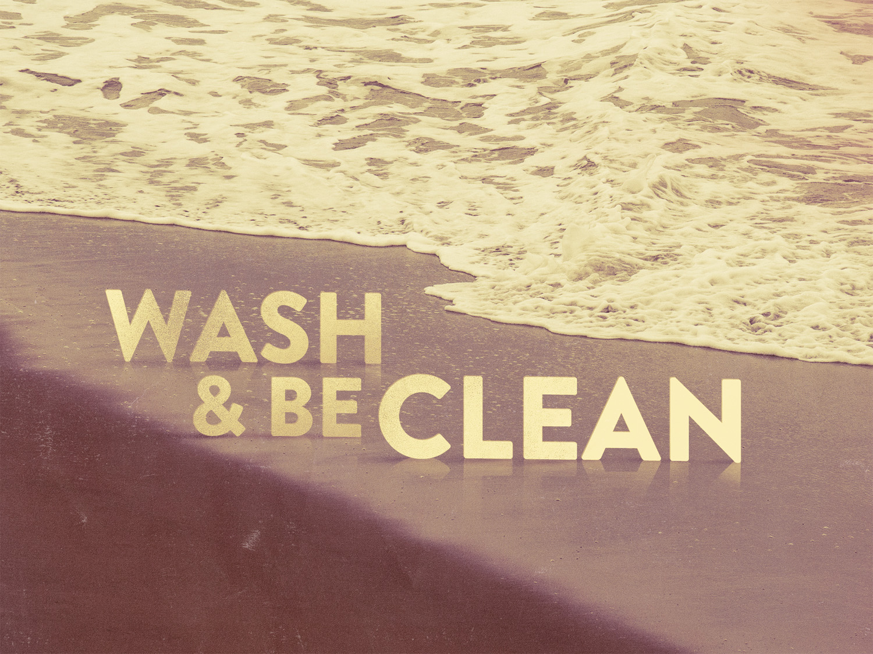

Slide 3
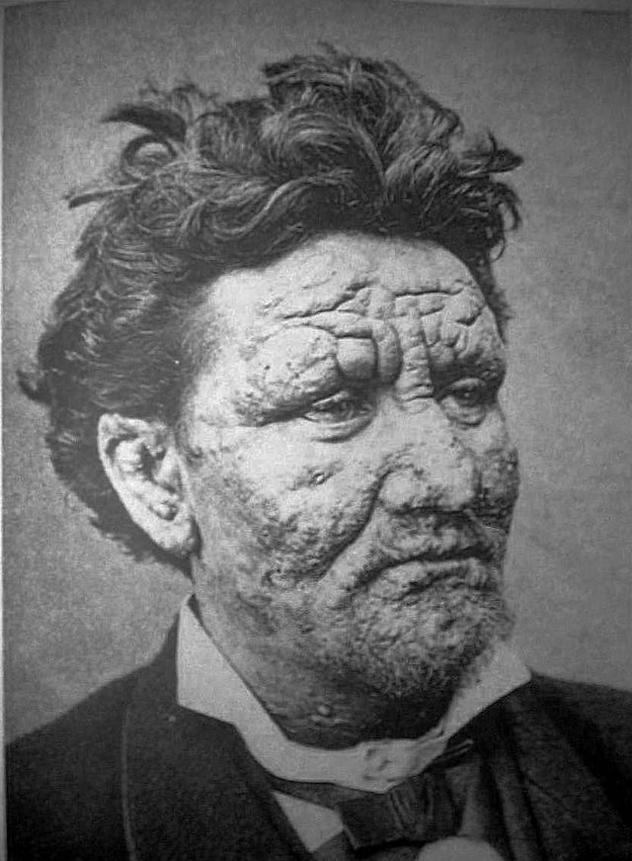

Slide 5
Many question WATER BAPTISM today.
NAAMAN, 2 Kings 5.1-14
His CLEANSING was on other side of water!

Slide 6
Many question WATER BAPTISM today.
NOAH & the flood, Gen. 6.5-8, 13-21, 22, 7.1, 5; Heb. 11.7
The new WORLD was on the other side of the water, 1 Peter 3.20

Slide 7
Many question WATER BAPTISM today.
Israel at the RED SEA, Exo. 14.10-14, 16, 26, 30; Psalm 106.6-12; Heb. 11.29
DELIVERANCE was on the other side of the water!

Slide 8
Many question WATER BAPTISM today.
BLIND man, John 9.1-7, 10-11, 14-15
His SIGHT was on other side of water!

Slide 9
Many question WATER BAPTISM today.
The SINNER & his salvation today, Eph.2.8; Heb. 5.9; Matt. 7.21; Mark 16.16; Acts 2.38; 22.16
SALVATION is on the other side of the water!

Slide 10
Did water make the blind man see?
Did the water deliver the Israelites?
Did water cleanse Naaman of his disease?
No, OBEDIENCE.
Was Adam & Eve condemned because of the fruit?
No, DISOBEDIENCE.

Slide 11
Many question the LORD’S CHURCH today.
They say, "one church is as GOOD as another."
What saith the scriptures? Matt. 16.18; Acts 20.28; Col. 1.18; Eph. 4.4; 5.23

Slide 12
Many question OBEDIENCE today.
He Demonstrated TRUSTING Faith by his obedience
When Naaman obeyed, he was cleansed ”…like the flesh of a little child” v14

