Slide 2
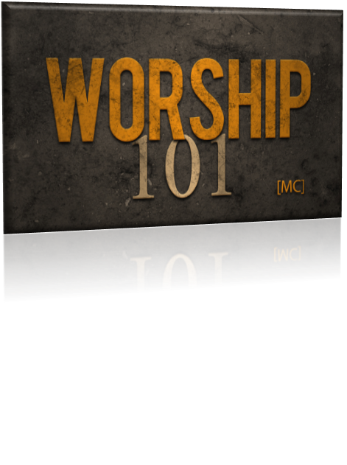
Isaiah 29:13

Slide 3
Have you brought something to the Lord today? What have you to offer? Are you here only to receive?

Slide 4
Worship is an ACT of WILL, a conscious DECISION to express REVERENCE for God
Isaiah 29:13

Slide 5
Fantastic PRAISE
“this people draw near with their mouth”
Isaiah 29:13

Slide 6
Fake PROCLAMATIONS
“and honor me with their lips”
Isaiah 29:13

Slide 7
Far-off POSITION
“while their hearts are far from me”
Isaiah 29:13

Slide 8
Forged PIETY
“their fear of me is a commandment taught by men”
Isaiah 29:13

Slide 9
Personal DECISION is missing
Peer DEPENDENCE
Problems and pressures DISTRACT
Priorities become DISTORTED
Price of DEDICATION
What’s happened to our worship?

Slide 10
Worship from the heart requires…
Focus on God and not on SELF, Deuteronomy 12:4-5
Isaiah 29:13

Slide 11
Worship from the heart requires…
Humble SUBMISSION, James 4:7-10
Isaiah 29:13

Slide 12
Worship from the heart requires…
VULNERABILITY before God, Philippians 4:6
Isaiah 29:13

Slide 13
Worship from the heart requires…
CHOICE, Joshua 24:15
Isaiah 29:13

Slide 14
The value of worship is lost when man makes his need and desire the purpose of worship. Worship is a response to God for all He is!
Hebrews 5:7

Slide 15
Isaiah 29:13

