Slide 3
Holy Spirit / Holy Ghost The Spirit of Truth The Comforter / Helper / Spirit of God The Spirit My Spirit His Spirit Spirit of the Lord
Names Of The Holy Spirit

Slide 4
"Jesus Christ, a little babe like all the rest of us have been, grew to be a man, was filled with a divine substance or fluid, called the Holy Spirit" (Key to Theology by Parley P. Pratt, p. 38) – Mormons "As for the 'Holy Spirit', the so-called 'third person of the trinity', we have already seen that it is, not a person, but God's active force." (The Truth That Leads To Eternal Life, pg. 24) - Jehovah's Witnesses
The Nature Of The Holy Spirit

Slide 5
Characteristics Of A Person
“Then God said, ‘Let us make man in our image, after our likeness…’” Gen. 1.26; Acts 17.29
God could not IMPART to man that which He did not POSSESS.
Everything our Creator IS we ARE except that we are FLESH and don’t possess DEITY, Gen. 6.3
Thus, all the Word needed to be made flesh was a PHYSICAL body, John 1.14; cf. Heb. 10.5

Slide 6
Characteristics Of A Person
A PERSON
FREE WILL
EMOTIONS
INTELLECT
CONSCIENCE

Slide 7
If the Holy Spirit can be shown to have these characteristics, then the Holy Spirit is a person, not a thing.
He GUIDES, hears, speaks, tells, John 16.12-13
He TEACHES, John 14.26
He SPEAKS, 1 Tim. 4.1; Acts 1.16; 8.29
He has KNOWLEDGE, 1 Cor. 2.11
He can be INSULTED, Heb. 10.29
He can make JUDGMENTS, Acts 5.3; 15.28
He has a WILL, 1 Cor. 12.11
| intellect
| emotions
| conscience
| will

Slide 8
The Holy Spirit is not an “IT,” but a “HE.”
A PERSON
FREE WILL
EMOTIONS
INTELLECT
CONSCIENCE

Slide 9
The Holy Spirit Is DEITY
He is GOD, Acts 5.3-4, 9
He is OMNISCIENT | knows all things, 1 Cor. 2.10-11
He is OMNIPRESENT | everywhere, Psalm 139.7-10
He is called the "ETERNAL" Spirit, Heb. 9.14
He helped CREATE the world, Gen. 1.2; Job 33.4
He is the SOURCE of miracles, Matt. 1.18-20; Acts 2.4, 33; Heb. 2.3-4

Slide 10
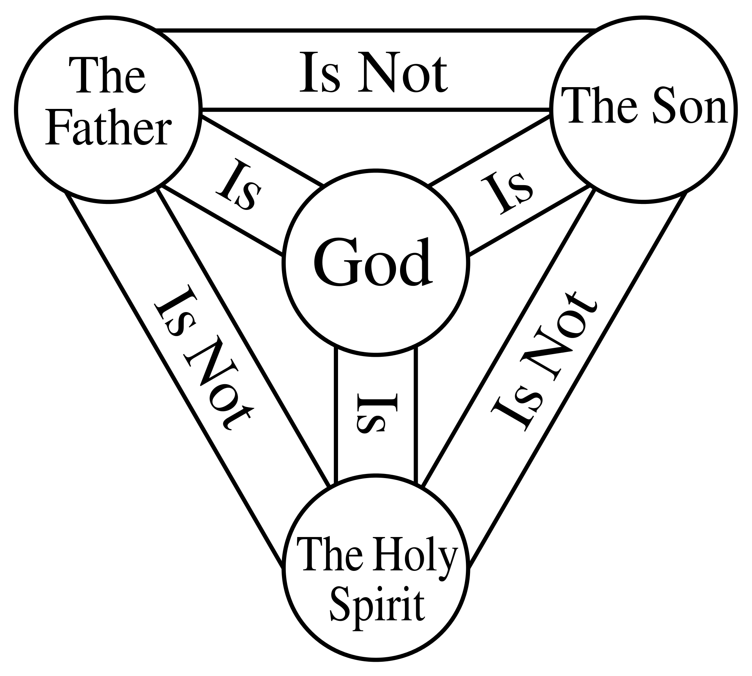
The Holy Spirit Is Deity, But Is Not…
One GOD, Deut. 6.4
But this is a COLLECTIVE “one,” not an absolute “one.” Gen. 1.26; 3.22-23
A HUSBAND and his WIFE are a collective “one,” not an absolute “one.” Gen. 2.24
Bryan, Jennie, Bentley and Maelie Garlock are a collective “one,” (family) not an absolute “one” (individual members).
Notes:
http://upload.wikimedia.org/wikipedia/commons/thumb/b/b3/Shield-Trinity-Scutum-Fidei-English.svg/520px-Shield-Trinity-Scutum-Fidei-English.svg.png

Slide 11
The Holy Spirit Is Deity, But Is Not…
Three Persons make up the Godhead, Matt. 29.19; Matt. 3.16-17
God the FATHER, Eph. 1.3
God the SON, Heb. 1.8-9
God the SPIRIT, Acts 5.3-4
There is one divine nature, but there are three distinct personalities!
Notes:
http://upload.wikimedia.org/wikipedia/commons/thumb/b/b3/Shield-Trinity-Scutum-Fidei-English.svg/520px-Shield-Trinity-Scutum-Fidei-English.svg.png

Slide 12
The Holy Spirit is God and DEMANDS our faith and obedience!
Christians - He can be GRIEVED, Eph. 4.30
Sinners - He can be RESISTED, Acts 7.51

