Slide 2
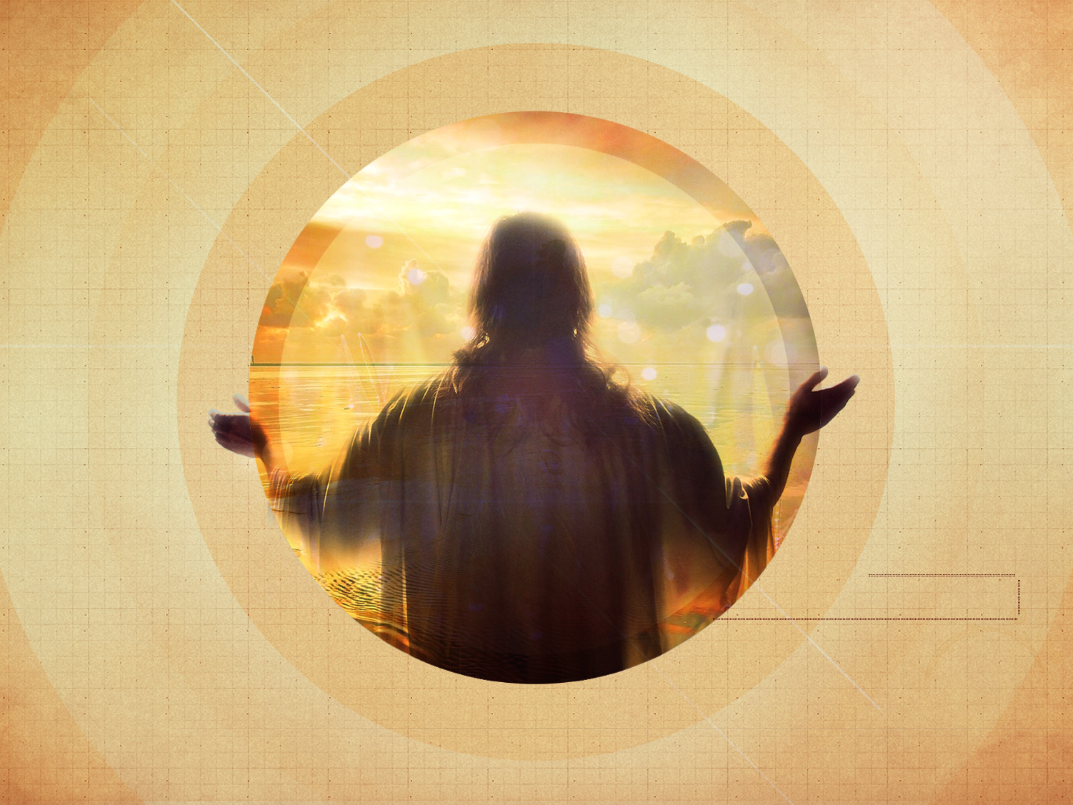
THE OUTSTRETCHED HANDS OF JESUS

Slide 3

Jesus Stretches His Hand Out…
To Identify His OWN
Those who do His will are His BROTHERS and SISTERS, Matt. 12.46-50
Doing His will requires OBEDIENCE (faithfulness), John 8.31-32; Matt. 7.24-27
There are those who are good, moral & even RELIGIOUS who Jesus does not identify as His own, Acts 2.5, 41; Acts 10.1-2; 47-48
Jesus would not call them brother & sister until AFTER they obeyed, Matt. 7.21

Slide 4
Jesus Stretches His Hand Out…
In Times Of TEMPTAION
Satan CANNOT back us into a comer in which we have no other choice but to sin!
Sometimes we must FLEE, 2 Tim. 2.22; 1 Cor. 6.18; cf. Gen. 39.11-12
Sometimes we need to stand and FIGHT, Eph. 6.11; cf. Matt. 4.1-10; cf. James 4.7
Always we must PRAY, Matt. 26.41; cf. 1 Thess. 5.17
Jesus stands with His hands stretched open for us to escape Satan and be comforted by Him!

Slide 5
Jesus Stretches His Hand Out…
To Help With Our WORRIES
We need to cast ALL our cares on Him, 1 Peter 5.7
  Worrying is DECEPTIVE!
  Worrying is TIME CONSUMING!
  Worrying does not PROMOTE the cause of cross!
  Worrying is a lack of FAITH, Luke 12.22-31
We need to GIVE it to Him; turn it over to Him!
When things are BOTHERING us, how often are we GOING to God in PRAYER?
In times of trouble, worry and strife we have Christ’s outstretched hands!

Slide 6
Jesus Stretches His Hand Out…
On The CROSS
Why did Jesus stretch out His hands on that cross for us?
He did so that we might have REMISSION of sins!
He was the LAMB of God to take away the sins of the world & to taste death for all men, John 1.29; Heb. 2.9
It was His BLOOD that was poured out for the forgiveness of sin, Matt. 26.28
He BOUGHT the church with His own blood, Acts 20.28
God offered Him as the PROPITIATION for our sins, 1 John 4.9-10

Slide 7
Jesus Stretches His Hand Out…
In Our SALVATION
He died, was buried & was resurrected by God so that we can have salvation through Him.
Jesus says, “Come to me, all who labor and are heavy laden, and I will give you rest.” Matt. 11.28; Rev. 22.17
“…All day long I have stretched out My hands to a disobedient and contrary people” Rom. 10.20-21

Slide 8

What’s HOLDING you back from TAKING Jesus’ hand?
God said, “hear Him” Matt. 17.5; Rom. 10.17
Jesus said, “…for unless you believe that I am he you will die in your sins.” John 8.24
Paul said God, “…commands all people everywhere to repent” Acts 17.30
Paul said, “…confess with your mouth that Jesus is Lord and believe in your heart that God raised him from the dead…” Rom. 10.9-10
Peter said, “Repent and be baptized every one of you in the name of Jesus Christ for the forgiveness of your sins…” Acts 2.38
John said, “…be faithful unto death, and I will give you the crown of life.” Rev. 2.10

